Slide 1

Web Programming
Introduction to Angular
Components, String Interpolation, Property Binding, Event and two-way Data Binding, and NgModules

Slide 2
Overview
About Angular
Importance of Angular
TypeScript Datatypes
TypeScript Namespaces
Elements of Angular
Components
String interpolation
Property Binding
Event and two – way databinding
NgModules

Slide 3

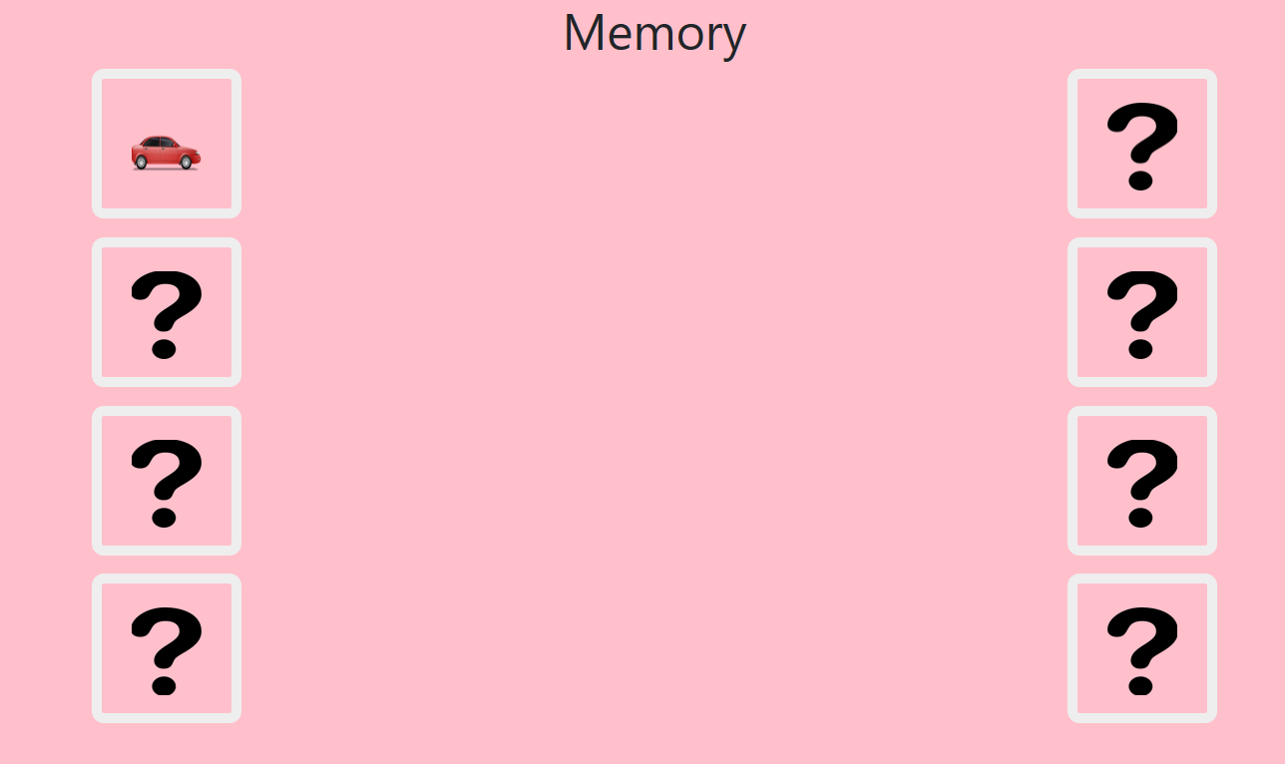
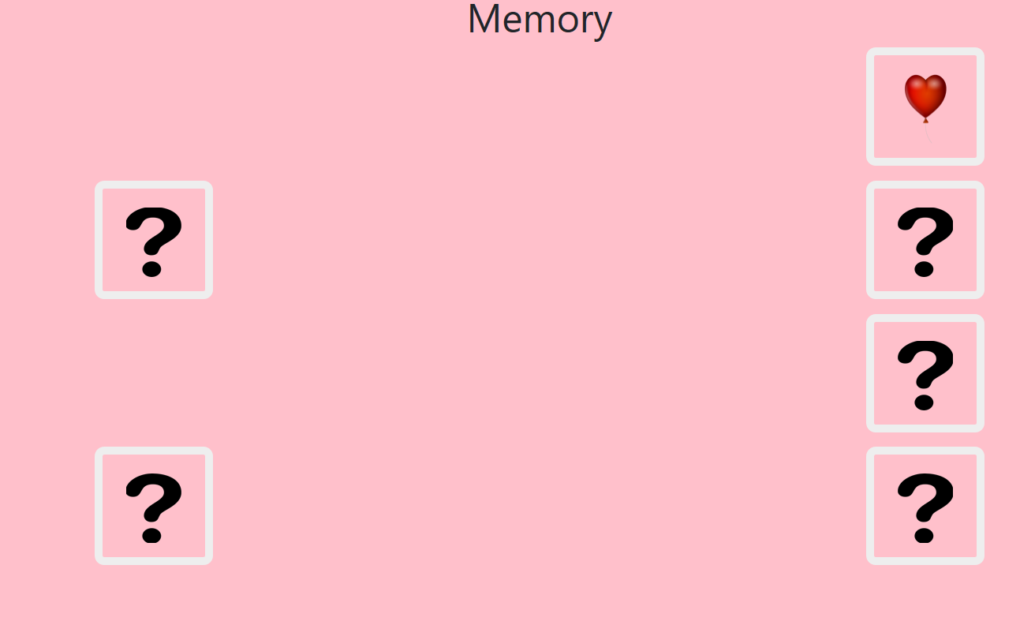
Use Case
Memory Game: Whenever matching tiles are selected user will get a congratulations message. Otherwise user will get chance to try next time.
Source: https://github.com/

Slide 4
What is Angular?
Angular is a front-end web framework designed by Google that relies on developers writing TypeScript
Angular and TypeScript are bringing true object-oriented web development to the mainstream
Angular is the frontend part of the MEAN stack, consisting of MongoDB database, Express.js web application server framework, Angular itself, and Node.js server runtime environment
AngularJS was originally developed in 2009 by Miško Hevery at Brat Tech LLC at Google. Angular is a complete rewrite from the same team that built AngularJS
Source: https://angular.io/

Slide 5
Why Angular?
If you're using JavaScript to create a dynamic website, Angular is a good choice
Angular helps you organize your business logic.
Angular helps create responsive (as in fast) websites.
Angular is perfect for Single Page Applications (SPAs)
Angular is easy to test
Angular is easy to learn
Angular extends HTML with new attributes
Angular is built around the philosophy that declarative code is better than imperative code
Source: https://angular.io/

Slide 6






Web Server
How Angular works?
Web Browser
URL Request to server
Response with Webpage & Assets
HTML
JavaScript
Browser loads up entire webpage.
User clicks on link, new Request
Response with Webpage & Assets
HTML
JavaScript
Browser loads up entire webpage.
Source: http://campus.codeschool.com/

Slide 7



Web Server
How Angular works?
Web Browser
URL Request to server
Response with Webpage & Assets
HTML
TypeScript
Browser loads up entire webpage.
User clicks on link, new Request
Response with JSON Data
DATA
Data is loaded into existing page.
Source: http://campus.codeschool.com/

Slide 8
AngularJS:
JavaScript framework for creating web and mobile single page apps.
Angular:
A complete rewrite of AngularJS and easier to learn than Angular 1.x
TypeScript allows code optimization using the OOPS concept.
Supports multiple languages(ES5, ES6, TypeScript and DART)
Modular (Everything is component based)
Performant (5X faster than Angular JS)

Slide 9
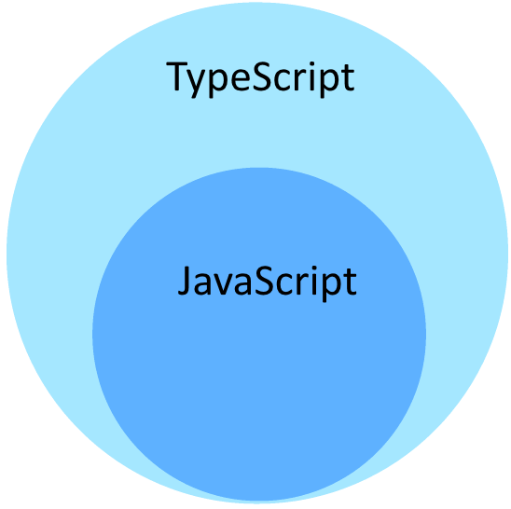
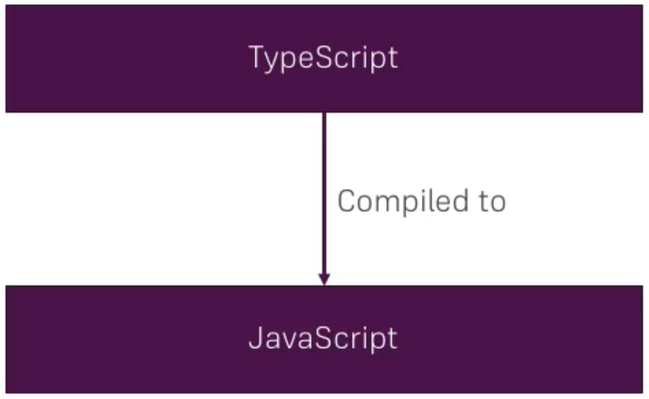
TypeScript..?

Slide 10
TypeScript..?
TypeScript is a language for application scale JavaScript development
TypeScript is a typed super set of JavaScript that compiles to plain JavaScript
TypeScript adds additional features like static type, Class, Module etc. to JavaScript
It is JavaScript compatible.
TypeScript purposefully borrows ideas from ECMAScript 6 (popularly ES 6)

Slide 11


Contd..
TypeScript supports Object Oriented Programming
TypeScript classes can implement interfaces
Inheritance
Instance methods/ members
Static methods/ members
Single Constructor
Default Optional parameters
ES6 class syntax
Syntax is minimized
E.g.: Arrow functions:

Slide 12
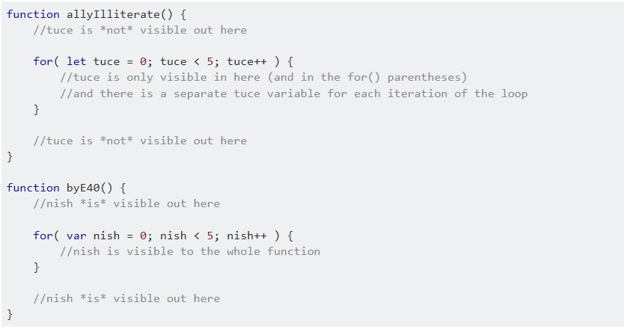
Difference between 'var' and 'let'
var and let are both used for function declaration in JavaScript but the difference between them is that var is function scoped and let is block scoped.
It can be said that a variable declared with var is defined throughout the program as compared to let.

Slide 13


TypeScript namespaces
A namespace is a way to logically group related code.
The classes or interfaces which should be accessed outside the namespace should be marked with keyword export.
To access the class or interface in another namespace, the syntax will be namespaceName.className
Notes:
https://www.tutorialspoint.com/typescript/typescript_namespaces.htm

Slide 14
Data Type | Keyword | Description
Number | number | It is used to represent both Integer as well as Floating-Point numbers
Boolean | boolean | Represents true and false
String | string | It is used to represent a sequence of characters
Void | void | Generally used on function return-types
Null | null | It is used when an object does not have any value
Undefined | undefined | Denotes value given to uninitialized variable
Any | any | If variable is declared with any data-type then any type of value can be assigned to that variable

Slide 15
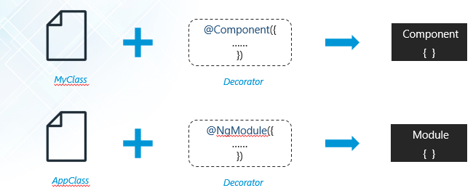
Decorator
In a simple terms, decorators allows you to attach meta data with the typescript class using which angular knows whether that class is a component or directive or module or etc.

Slide 16
How Angular app starts
Index.html will be served by local host
index.html -> main.ts -> AppModule -> AppComponent
app.component.ts -> app.component.html

Slide 17
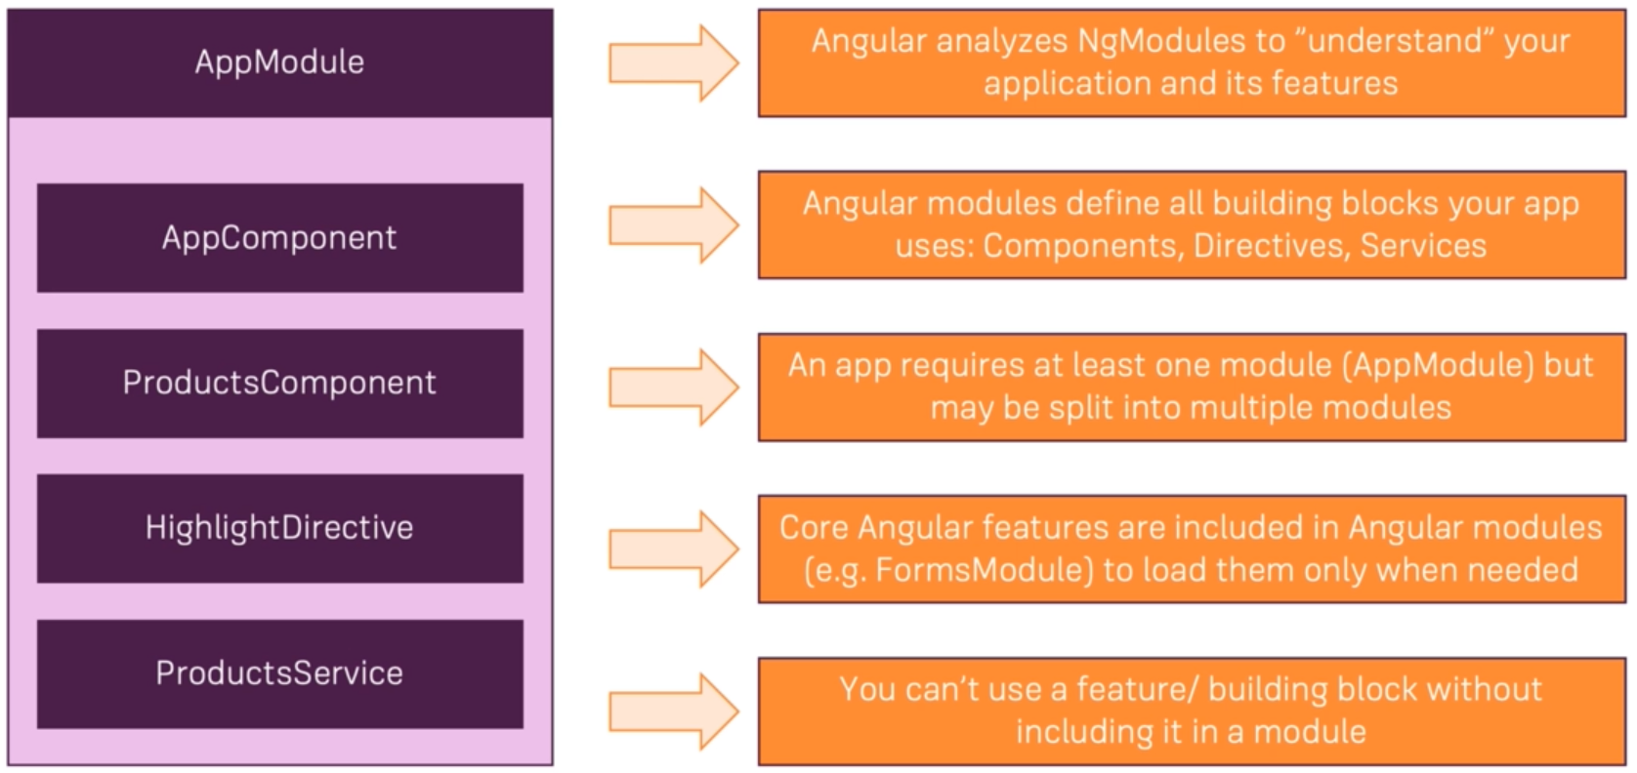
Module

Slide 18
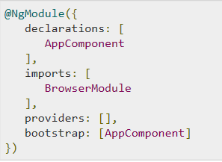
Module
To define module, we can use the NgModule.
Notes:
Module in Angular refers to a place where you can group the components, directives, pipes, and services, which are related to the application.

Slide 19
NgModule
Angular apps are modular and Angular has its own modularity system called NgModules
NgModules are containers for a cohesive block of code dedicated to an application domain
NgModule contains components, service providers, and other code files whose scope is defined in them.

Slide 20
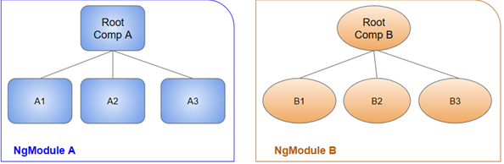
..continued(NgModule)
A root NgModule always has a root component that is created during bootstrap.
Any NgModule can include any number of additional components, which can be loaded through the router or created through the template.

Slide 21
..continued(NgModule)
The purpose of a NgModule is to declare each thing you create in Angular, and group them together (like Java packages or PHP / C# namespaces).
"imports" makes the exported declarations of other modules available in the current module
“declarations” is for things you’ll use in your templates: mainly components (~ views: the classes displaying data), but also directives and pipes,
“providers” is for services (~ models: the classes getting and handling data).

Slide 22
Components
Angular app contains a tree of components
Component must belong to NgModule to be available for other component to access
The following files are created in the new component folder named 'new-cmp'
new-cmp.component.css − css file for the new component is created.
new-cmp.component.html − html file is created.
new-cmp.component.spec.ts − this can be used for unit testing.
new-cmp.component.ts − here, we can define the module, properties, etc.
Notes:
Components are basically classes that interact with the .html file of the component, which gets displayed on the browser

Slide 23
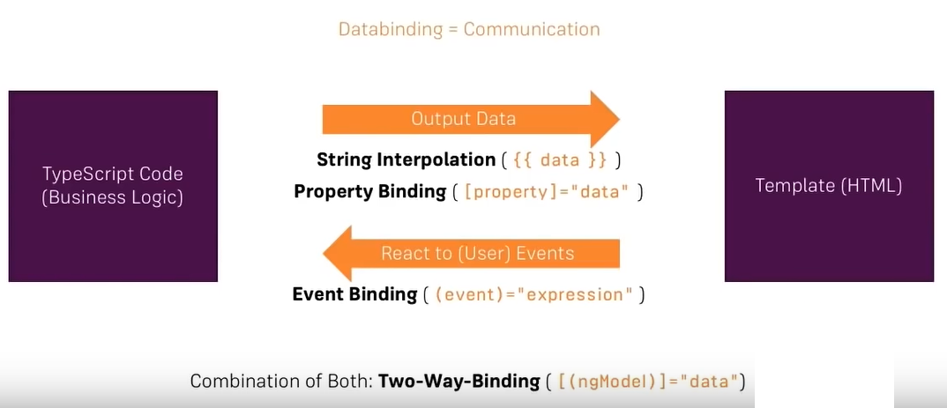
Data Binding(communication)

Slide 24
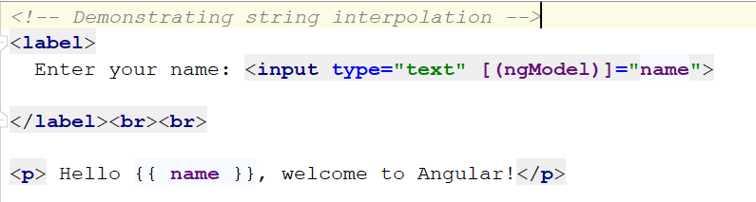
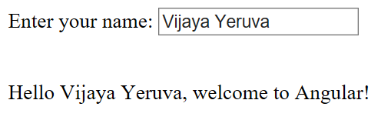
String interpolation
It is also called one-way data binding
It uses template expressions in double curly {{ }} braces to display data from the component

Slide 25
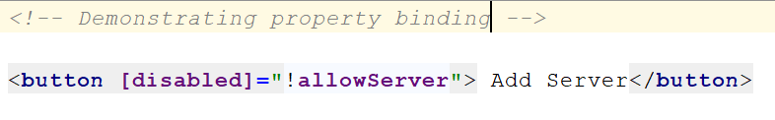
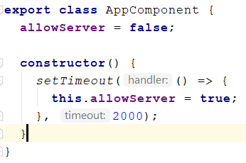
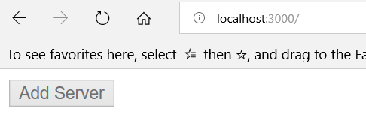
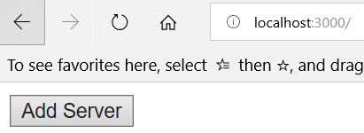
Property binding
Property binding is the primary way of data binding in angular to pass data between components
The square brackets are used to bind the property of an element E.g.: [property]

Slide 26
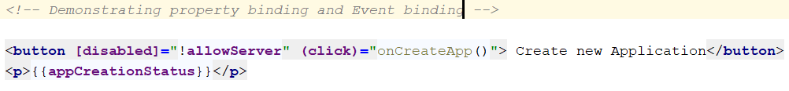
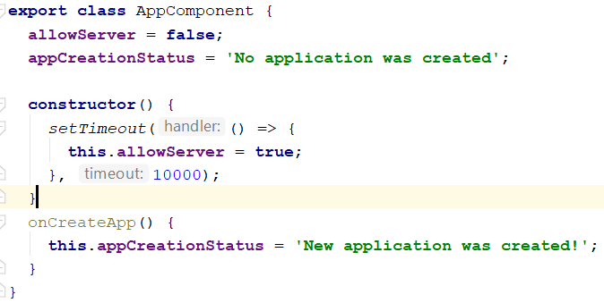
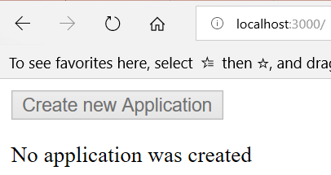
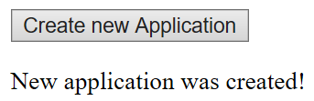
Event binding
When a user interacts with an application in the form of a keyboard movement, a mouse click, or a mouseover, it generates an event.
These events need to be handled to perform some kind of action.

Slide 27
Two-way data binding:
It is simply a combination of both Property binding and Event binding
When properties in the model get updated, the UI gets updated.
When UI elements get updated, the changes get propagated back to the model.

Slide 28
Directives
We have 3 directives in Angular.
Component Directives
These form the main class having details of how the component should be processed, instantiated and used at runtime.
Structural Directives
A structure directive basically deals with manipulating the DOM elements. Structural directives have a * sign before the directive. For example, *ngIf and *ngFor.
Attribute Directives
Attribute directives deal with changing the look and behavior of the DOM element.

Slide 29
ICP
Please refer steps in the lesson plan

Slide 30
References
Example Angular Bootstrap App
https://en.wikipedia.org/wiki/Angular
Angular Developer Guide
Angular API
Angular Tutorial
Angular CLI wiki
TypeScript
Videos
Angular Fundamentals In 50-ish Minutes
Angular 5 Complete Tutorial
Build Apps using Node JS and Angular
Notes:
https://www.quora.com/What-is-decorator-in-angular-2
https://stackoverflow.com/questions/40073941/whats-the-difference-between-an-angular-component-and-module
https://stackoverflow.com/questions/762011/whats-the-difference-between-using-let-and-var-to-declare-a-variable-in-jav

